Slide 1
SKIN
By
Dr.Mahadevi A.L
Dept of Physiology
SKHMC

Slide 2
STRUCTURE OF SKIN
Skin is the largest organ of the body.
It is not uniformly thick and at some places it is thin.
The average thickness of skin is about 1-2mm.
In the sole of the foot, palm of the hand and in the interscapular region, it is considerably thick, measuring about 5mm.
In other areas of the body, the skin is thin.
It is thinnest over eyelids and penis, measuring about 0.5mm only.

Slide 3
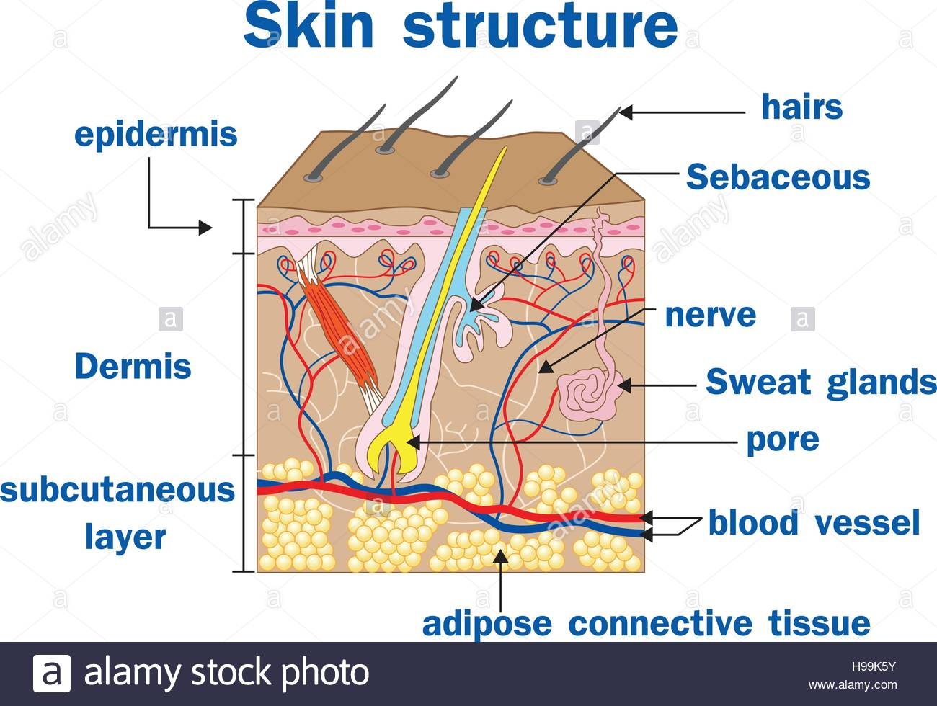

Slide 4
LAYERS OF THE SKIN
Skin has three layers:
The epidermis, the outermost layer of skin, provides a waterproof barrier and creates our skin tone.
The dermis, beneath the epidermis, contains tough connective tissue, hair follicles, and sweat glands.
The deeper subcutaneous tissue (hypodermis) is made of fat and connective tissue.

Slide 5
Epidermis
It is the outer layer of skin.
It is formed by stratified epithelium.
Important feature of epidermis is that, it does not have blood vessels.
Nutrition is provided to the epdermis by the capillaries of dermis

Slide 6
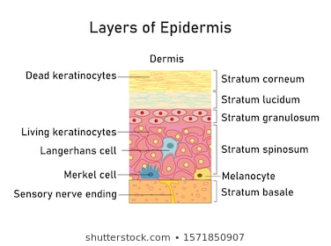

Slide 7
The epidermis is itself divided into at least four separate parts. A fifth part is present in some areas of our body.
In order from the deepest layer of the epidermis to the most superficial, these layers (strata) are the:
Stratum basale(Stratum germinativum)
Stratum spinosum
Stratum granulosum
Stratum lucidum
Stratum corneum

Slide 8
STRATUM CORNEUM
It is also known as horny layer. It is the outermost layer and consists of dead cells, which are called corneocytes.
These cells lose their nucleus due to pressure an become dead cells
The cytoplasm is flattened with fibrous protein known as keratin.
Apart from this these cells also contain phospholipids and glycogen.

Slide 9
STRATUM LUCIDUM
It is made up of flattened epithelal cells.
Many cells have degenerated nucleus and in some cells, the nucleus is absent.
As these cells exhibit shiny character, the layer looks like a homogenous translucent zone.
So this layer is called stratum lucidum (lucid=clear).

Slide 10
STRATUM SPINOSUM
It is also known as prickle cell layer because, the cells of this layer possess some spine-like protoplasmic projections.
By these projections, the cells are connected to one another.

Slide 11
STRATUM GERMINATIVUM
It is a thick layer made up of polygonal cells, superficially and columnar or cuboidal epithelial cells in the deeper parts.
Here, new cells are constantly formed by mitotic division.
The newly formed cells moved continuously towards the stratum corneum.
The stem cells ,which give rise to new cells, are known as keratinocytes.

Slide 12
Another type of cells called melanocytes are scattered between the keratinocytes.
Melanocytes produce the pigment called melanin.
The color of the skin depends upon melanin.
From this layer, some projections called rete ridges extend down upto dermis.
These projections provide anchoring and nutritional function.

Slide 13
DERMIS
The dermis is the layer of skin that lies beneath the epidermis and above the subcutaneous layer.
It is the thickest layer of the skin, and is made up of fibrous and elastic tissue.
Thus it provides strength and flexibility to the skin.

Slide 14
Layers
The dermis is comprised of two layers:
the papillary dermis and
the reticular dermis.
The papillary dermis is the more superficial of the two, and lies just beneath the epidermal junction. It is relatively thin and is made up of loose connective tissue, which includes:
Capillaries
Elastic fibers
Reticular fibers
Collagen

Slide 15
The reticular dermis is the deeper and thicker layer of the dermis, which lies above the subcutaneous layer of the skin.
It contains dense connective tissue, which includes:
Blood vessels
Elastic fibers (interlaced)
Collagen fibers (in parallel layers)
Fibroblasts
Mast cells
Nerve endings
Lymphatics

Slide 16
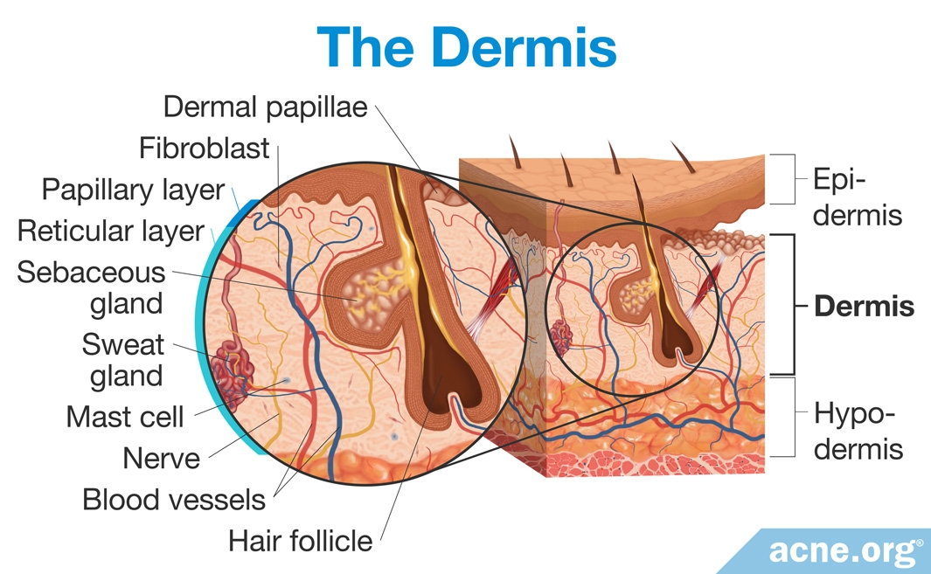

Slide 17
APPENDAGES OF SKIN
Hair follicles with hair, nails,
sweat glands,
sebaceous glands and mammary glands are considered as appendages of the skin.

Slide 19
COLOR OF SKIN
It depends upon two important factors
1.Pigmentation of the skin
2.Hemoglobin in the blood

Slide 21
MELANIN
It is the skin pigment and it forms the major color determinant of human skin.
Skin becomes dark when melanin content increases
It is protein in nature and it is synthesized from the aminoacid tyrosine via DOPA(Dihydroxyphenylalanine)
Deficiency of melanin leads to albinism(hypopigmentary congenital disorder)

Slide 22
2.HEMOGLOBIN IN THE BLOOD
Amount and nature of hemoglobin that circulates in the cutaneous blood vessels play an important role in the color of the skin.
Skin becomes:
1.pale, when hemoglobin content decreases2.pink,when blood rushes to skin due to cutaneous vasodilatation(blushing)3.bluish during cyanosis,which is caused by excess amount of reduced hemoglobin.

Slide 24
GLANDS OF THE SKIN
Sebaceous gland:
Sebaceous glands are the oil secreting glands of your body. This is why they are also called the oil glands. They are a type of holocrine simple saccular (alveolar) gland.
Their function is to secrete a substance called sebum, a mixture of fatty substances, entire sebum-producing cells, and epithelial cell debris.
The sebaceous glands are located in the dermis, the middle layer of the skin, and they develop from the epithelial cells of the hair follicle itself (the external root sheath of the hair

Slide 25
Sebaceous gland ducts thus usually open up into the upper part of a hair follicle, called the infundibulum. The infundibulum is part of the pilosebaceous canal, the one responsible for discharging sebum and one that is composed of the infundibulum and the short duct of the sebaceous gland itself.
However, some sebaceous gland ducts open directly onto our skin surface such as at the corner of the mouth and the glans penis.
Regardless, the secretion of sebum out of the gland is helped along by the contraction of the arrector pili muscle.
While the sebaceous glands are present just about all over the skin, they are notably absent on the palms of the hands and the soles of the feet. The sebum being excreted by your body today began production around 8 days ago.

Slide 26
Sweat (Sudoriferous) Glands
Sweat glands, also called sudoriferous glands, are simple tubular glands found almost everywhere on our body.
Each sweat gland is made up of two portions:
A secretory section
An excretory duct
The secretory portion is found in the dermis, the middle layer of the skin. Sometimes it’s also found in the hypodermis, the deepest layer of our skin.

Slide 27
Function of sebum
The sebum produced by these glands plays numerous important roles:
Sebum is a lubricant and inasmuch it helps to moisturize the skin. It does so by preventing the excess evaporation of water from the skin.
Sebum serves to keep us healthy by keeping in check the growth of certain bacteria on our skin. That’s because sebum contains chemicals that kill bacteria. This helps ensure bacteria don’t invade into deeper layer of our skin.
It helps to condition the hair. Meaning, it ensures our hair doesn’t become too dry and brittle.

Slide 28
sebaceous glands are involved in numerous conditions.
During puberty, various hormones cause them to produce a lot of sebum and this therefore contributes to oily skin.
If a duct of a sebaceous gland is clogged with sebum, a whitehead results.
If this material is allowed to dry and oxidize, it will become darker, forming a blackhead.
If a sebaceous gland becomes infected, moderate and severe forms of acne are the result.

Slide 29
SWEAT GLANDS
The secretory portion of a sweat gland is a twisted and coiled tube that has an opening at its very top.
It is in the coiled secretory portion of the sweat gland where the sweat is actually produced.
The excretory duct moves from the secretion portion, through the dermis, and into the topmost layer of the skin, the epidermis, where it opens up at the surface of our skin.

Slide 30
Eccrine Glands
Human Skin: Cross sectional image of skin showing a sweat gland and a sebaceous gland.
The most numerous types of sweat glands in our skin, found almost everywhere on the body, are called eccrine glands. These are the true sweat glands in the sense of helping to regulate body temperature.
In other words, sweating causes the loss of body heat and thus cools us down on a hot day or when performing strenuous exercise.
This is because as the water in sweat evaporates, it takes body heat with it.

Slide 31
The total volume of sweat produced depends on the number of functional glands and the size of the surface opening.
The degree of secretory activity is regulated by neural and hormonal mechanisms (men sweat more than women).
When all of the eccrine sweat glands are working at maximum capacity, the rate of perspiration for a human being may exceed three liters per hour, and dangerous losses of fluids and electrolytes can occur.

Slide 32
Eccrine glands have three primary functions:
Thermoregulation: sweat cools the surface of the skin and reduces body temperature.
Excretion: eccrine sweat gland secretion can also provide a significant excretory route for water and electrolytes.
Protection: eccrine sweat gland secretion aids in preserving the skin's acid mantle, which helps protect the skin from colonization from bacteria and other pathogenic organisms.

Slide 33
Apocrine Glands
The other kind of sweat glands are known as apocrine glands. The apocrine glands are found in places like the armpits, scrotum, anus, and labia majora.
They are typically larger than eccrine glands and their ducts tend to open into hair follicles instead of hairless areas of skin.
These glands, unlike the eccrine glands, serve virtually no role in the regulation of body temperature.
These are also the glands largely responsible for body smells, as their excretions are converted by skin bacteria into various chemicals we associated with body odor, they are activated during times of stress, pain, and sexual foreplay

Slide 34
Before puberty, the apocrine sweat glands are inactive; hormonal changes in puberty cause the glands to increase in size and begin functioning.
The substance secreted is thicker than eccrine sweat and provides nutrients for bacteria on the skin: the bacteria's decomposition of sweat is what creates the acrid odor.
Apocrine sweat glands are most active in times of stress and sexual excitement.

Slide 35
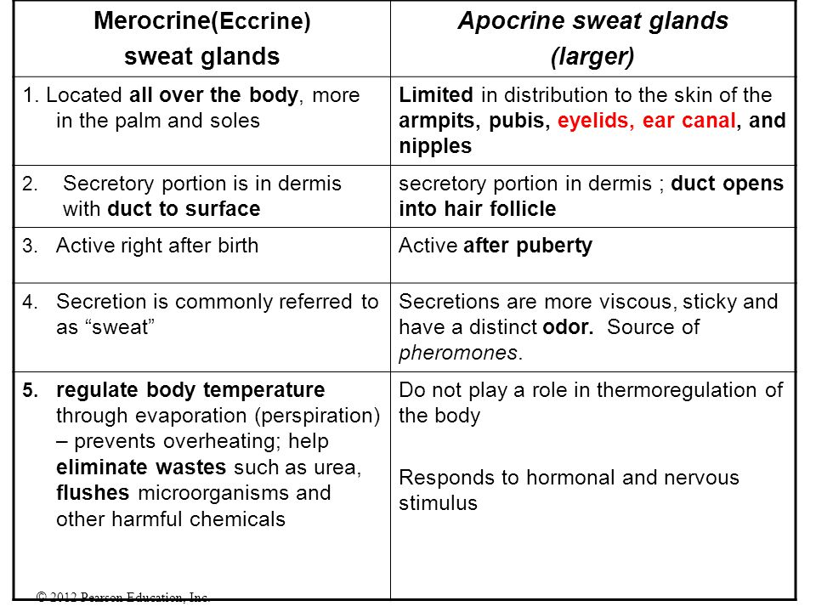

Slide 36
Thank u

